Slide 1


Power Ahead Group
The First American Sodium-Ion Battery Energy Storage System Integrator
INTRODUCTION: MEGA-SIB
The World's Largest Cylindrical Sodium-Ion Battery
www.PowerAheadGroup.com

Slide 2

Background:
Tesla as a Comparator
2

Slide 3

Tesla’s Shanghai Energy Storage Megapack Factory Has Been Completed and Trial Production Has Begun *
Taking only 7 months from breaking ground to completion, Tesla's Shanghai Energy Storage Megapack Factory has already begun trial production of its Megapack commercial energy storage battery system.
Megapack is recognized as the world's largest electrochemical energy storage equipment to date.
It is reported that each Megapack unit can store more than 3.9MWh of energy – enough to meet the one-hour electricity demand of 3,600 families.
Tesla's Shanghai energy storage plant plans to produce 10,000 Megapacks annually, with an energy storage scale of nearly 40 GWh to supply the global market.
* Information from Article - China Securities Times, 2025.01.09
3

Slide 4
Tesla’s Energy Storage is “Soaring”
Tesla breaks another record in the fourth quarter 2024 with a quarterly deployment of 11 GWh
On an annual basis, in 2024, Tesla's energy storage deployment reached 31.4 GWh, another record and an increase of 100% compared with the 2023 deployment of 15.7 GWh.
(Source: China Energy Storage Network)
4

Slide 5
Tesla’s Market Share and Growth Potential
According to Szechuan’s Chaodian Think Tank, in Q1 of 2023, Tesla accounted for 28% of the market share among large-sized integrators in the United States, ranking first.
NextEra, Fluence and Powin account for 14%, 10% and 10% of the market share, respectively.
Tesla CEO Elon Musk said that Tesla's energy storage business may even surpass its electric vehicle business in the future, noting that Tesla plans to build an energy storage project on a scale of 100GWH.
Tesla's energy storage business could have future growth of more than 10x.
5

Slide 6
Tesla Eyed as Key Investment (Continued)
For Morgan Stanley, Tesla’s biggest future draw is its new energy and energy storage business.
On June 25, 2024, Morgan Stanley released a report that Tesla held a "key card" and would be the key "winner" of the next round of AI investment. This ”trump card" is not Tesla's AI or robot business, but its solar energy and energy storage business.
Morgan Stanley analyst Adam Jonas is firmly optimistic about Tesla's energy storage business – he believes that the the electricity demand brought about by the AI boom will establish Tesla as a key player in the U.S. energy market.
Source: Wallstreetcn, 2024.06.26, Morgan Stanley, In the next round of AI investments, Tesla is the key "ace in the hole”.
6

Slide 7
Tesla Eyed as Key Investment (Continued)
Jonas said that AI data centers are currently being built across the United States, which will incarnate as "power-swallowing beasts" and bring a huge load to the U.S. power grid.
Jonas predicted Tesla Energy's revenue would exceed $7 billion in fiscal year 2024, and by 2025, its profit margin may exceed that of Tesla's automotive business.
In the future, Tesla's energy storage business will grow faster than its solar energy business. And by 2030, it will be making a significant contribution to Tesla's overall profitability and give Tesla Energy a forecast valuation of $130 billion.
Source: Wallstreetcn, 2024.06.26, Morgan Stanley, In the next round of AI investments, Tesla is the key "ace in the hole”.
7

Slide 8
Energy Storage Systems:
Why Sodium-Ion Batteries over Lithium-Ion Batteries?
8

Slide 9

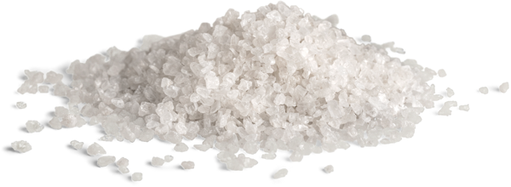
Benefits of
Sodium-Ion Batteries
Problems with
Lithium-Ion Batteries
Safe
Lower cost
Unlimited resource
High performance
Wider temperature tolerance
Recyclable
Longer lifespan
Safety concerns
Temperature challenges
High raw material costs
Low recyclability
Limited resource
9

Slide 10
Energy Storage Systems:
Does Size Matter?
10

Slide 11
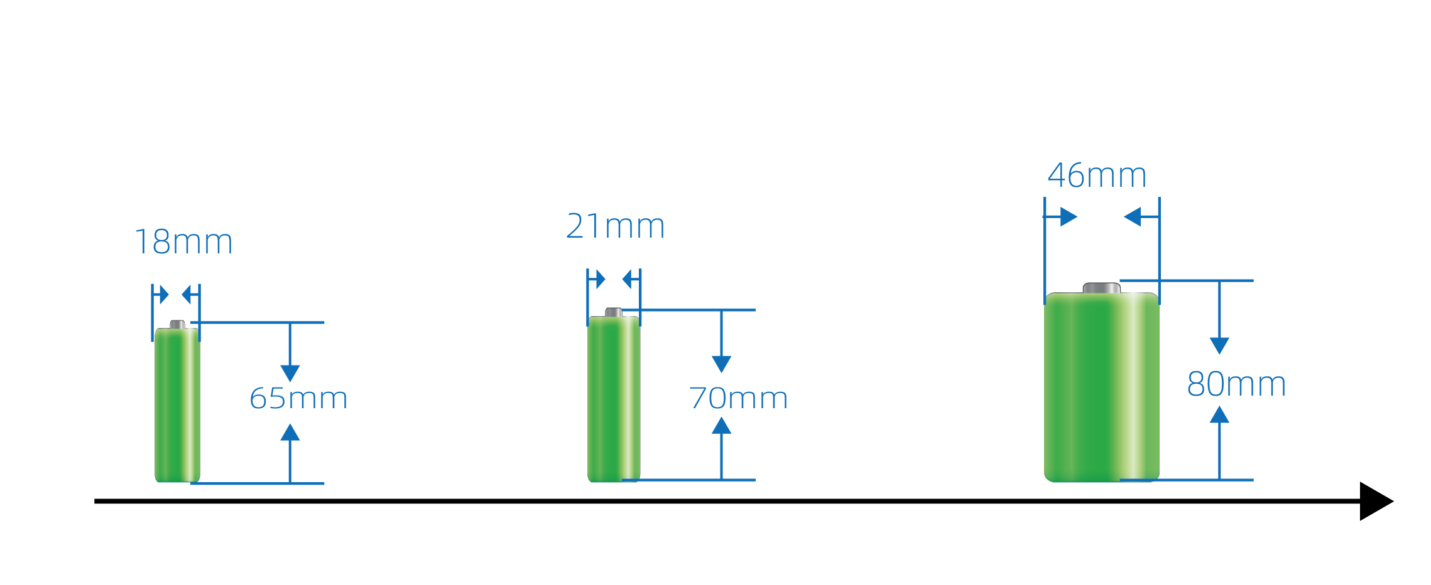
Tesla Development History of Cylindrical Batteries
Size:
Type:
Year:
Manufacturer:
Application:
1865
Lithium Ion Battery
1990
Sony
Tesla Roadster
Energy Storage
2170
Lithium Ion Battery
2017
Tesla and Panasonic
Tesla Model 3
Energy Storage
4680
Lithium Ion Battery
2020
Tesla
Tesla Model Y
Energy Storage
This is an 8-fold increase in battery volume over a 30 year span.
11

Slide 12
Introducing MEGA-SIB:
The World's Largest Cylindrical Sodium Ion Battery from Power Ahead Group
12

Slide 13
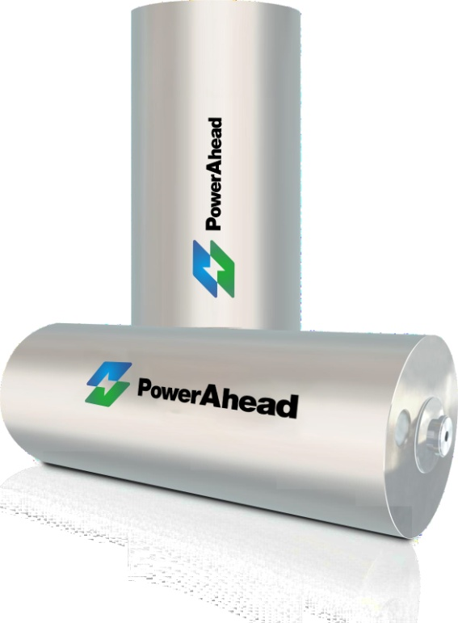
Introducing MEGA-SIB
The World's Largest Cylindrical Sodium Ion Battery from Power Ahead Group
Type: 120420
Capacity：3.0V/280Ah
13

Slide 14
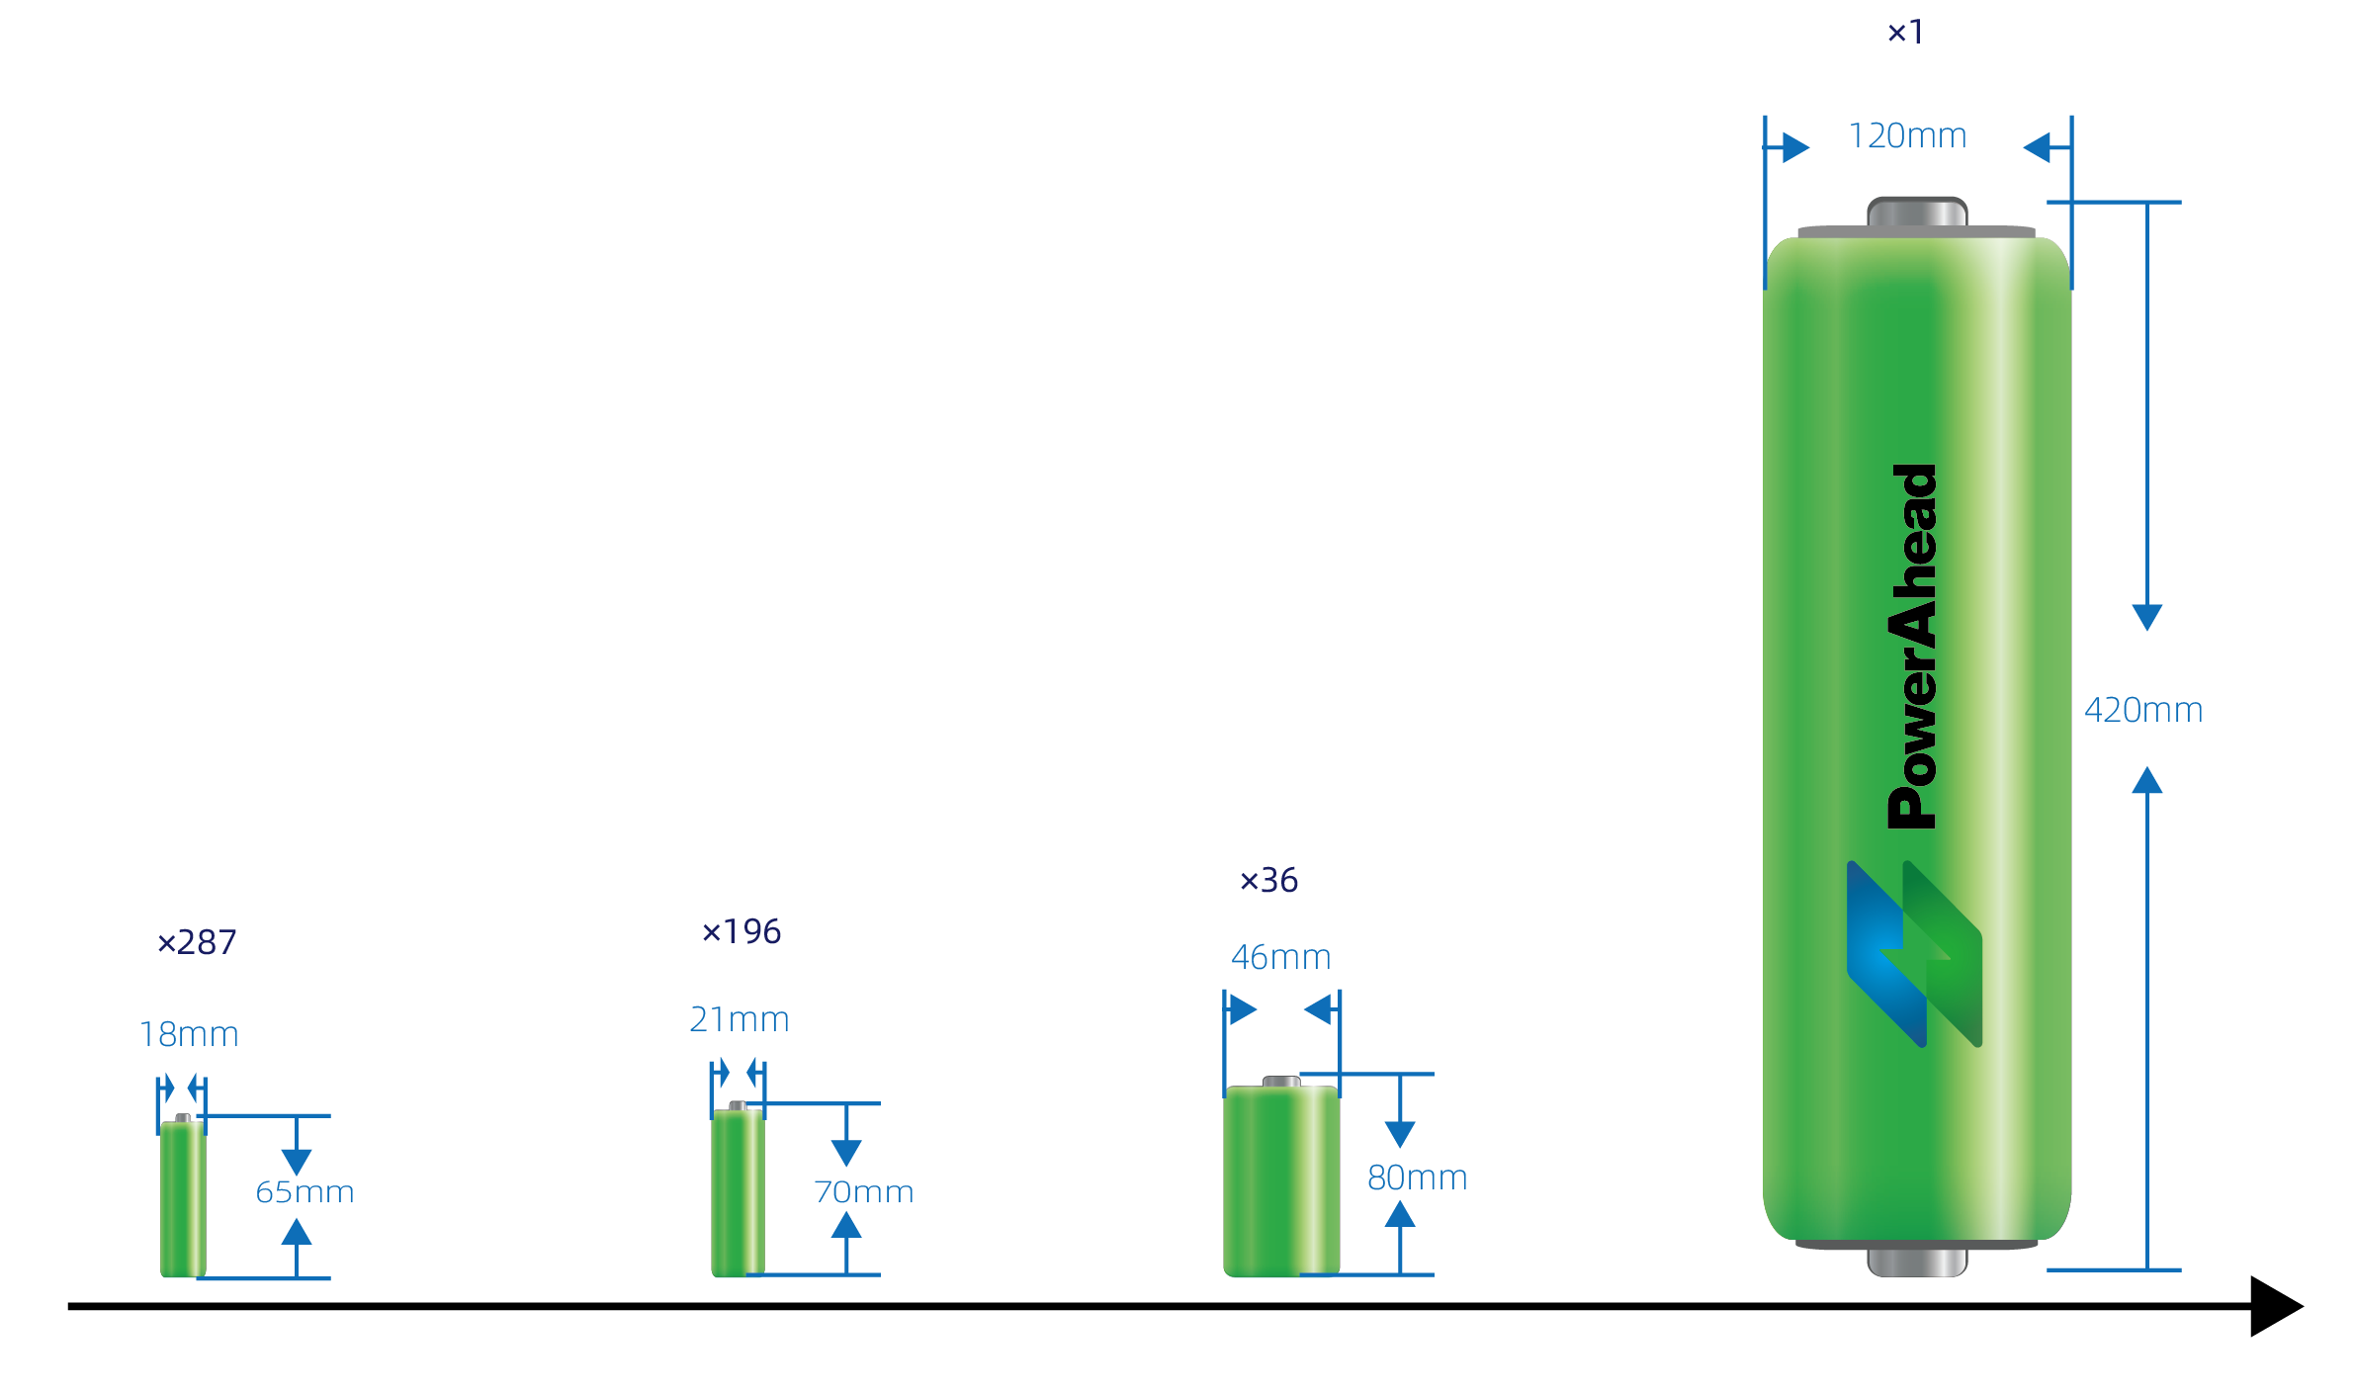
Size Comparison – Tesla’s Batteries vs Power Ahead Group’s MEGA-SIB Battery
Power Ahead Group’s MEGA-SIB Battery is 36 times as large (volumetric) compared to Tesla’s 4680 battery.
Size:
Type:
Year:
Manufacturer:
Application:
1865
Lithium Ion Battery
1990
Sony
Tesla Roadster
Energy Storage
2170
Lithium Ion Battery
2017
Tesla and Panasonic
Tesla Model 3
Energy Storage
4680
Lithium Ion Battery
2020
Tesla
Tesla Model Y
Energy Storage
120420
Sodium Ion Battery
2024
Power Ahead Group
Energy Storage
14

Slide 15
MEGA-SIB’s Advantages
1. Safety
  Lithium-ion batteries are vulnerable to catching fire and/or exploding – high temperature, over-charge/discharge, compression, punctures, collisions, can cause lithium batteries to catch fire and explode. Lithium-ion batteries are extremely unsafe as energy storage solutions.
  Sodium-ion batteries solve the safety pain points that exist in lithium-ion batteries. MEGA-SIB batteries use polyanion positive electrode materials, which are very safe, not flammable, and not prone to explosion risks. Sodium-ion batteries, in terms of safety, are a far superior option for energy storage.
  MEGA-SIB has a temperature-controlled ejection system, providing an additional layer of safety and performance security.
  This system provides constant temperature monitoring of each battery within a configuration. When a battery exceeds a predetermined temperature (e.g., 60 ℃), it will be immediately “removed” from the configuration . This dual insurance ensures the safety and efficiency of the entire MEGA-SIB system.
15

Slide 16
MEGA-SIB’s Advantages Cont’d
2. High Production Efficiency
  The capacity of one MEGA-SIB is equivalent to:
    - 36 units of 4680 battery
  - 196 units of 2170 battery
  - 287 pieces of 1865 battery
  Manufacturing fewer and larger batteries requires less production equipment, a smaller factory area, smaller land area, and fewer workers
3. Cost Advantages
Compared with other cylindrical batteries, MEGA-SIB:
Saves 66% of shell material + 36 welding points compare with 4680 battery
Saves 83% of shell material + 195 welding points compare with 2170 battery
Saves 85% of shell material + 287 welding points compare with 1865 battery
16

Slide 17
MEGA-SIB’s Advantages Cont’d
4. High Performance
  MEGA-SIB uses a polyanion plus hard carbon system, bringing high safety and long cycle times, with cycle times exceeding 6000 cycles
  The discharge capacity retention rate at -40 ℃ is ≥ 89%, bringing excellent advantages in high-altitude/latitude regions
  Full pole ear technology reduces battery internal resistance and minimizes battery heating
5. Assembly Advantages
  The capacity of one MEGA-SIB battery is 0.8 KWh, which can obviate the PACK process and thereby achieve high assembly efficiency
  Each module uses fewer battery cells and fewer connecting materials
17

Slide 18
MEGA-SIB’s Advantages Cont’d
6. Convenient Manager for
Battery Pack
  The module requires fewer battery cells and fewer BMS control points, making it easier to manage the system
  Using same-capacity for a PACK comparison, MEGA-SIB can bring reductions of :
    286 control points compared with a 1865 battery
    194 control points compared with a 2170 battery
    36 control points compared with a 4680 battery.
7. Ease of Replacement
  When a battery cell reaches end of life, other components in the energy storage system can continue to be used—only the battery cell need be replaced.
  The cost of battery replacement is as low as $27.4/kWh, greatly reducing the cost of the energy storage system.
18

Slide 19
MEGA-SIB’s Advantages Cont’d
8. Environmental
Advantages
  MEGA-SIB does not contain lithium ions or other toxic elements such as cobalt and nickel.
  The recycling process is environmentally friendly and low cost, and the recycled materials can be used for new batteries.
19

Slide 20
MEGA-SIB:
Energy Storage Products
20

Slide 21

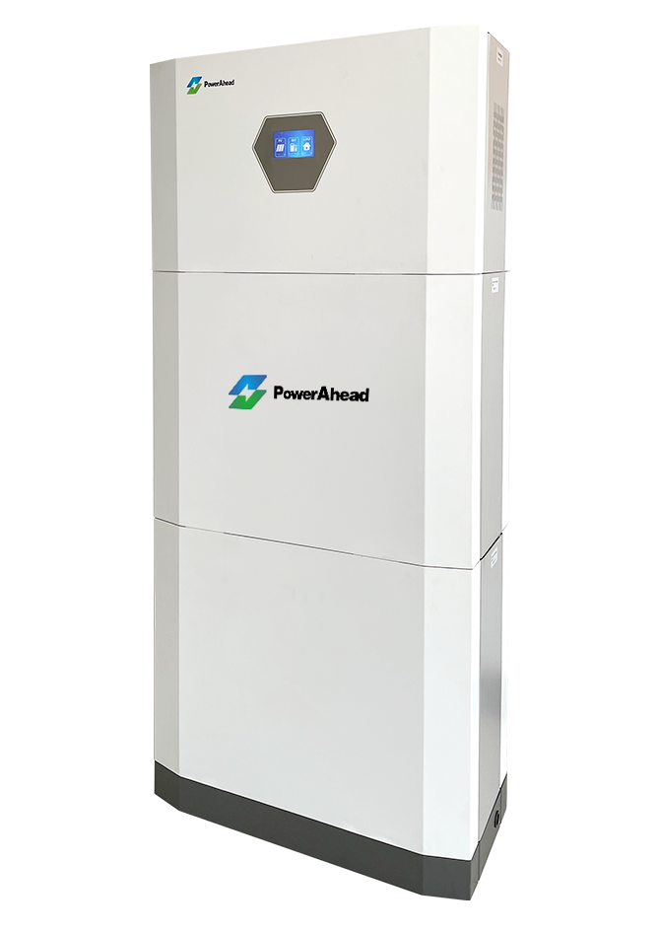
Residential Energy Storage
Capacity: 5-100 KWh
21

Slide 22
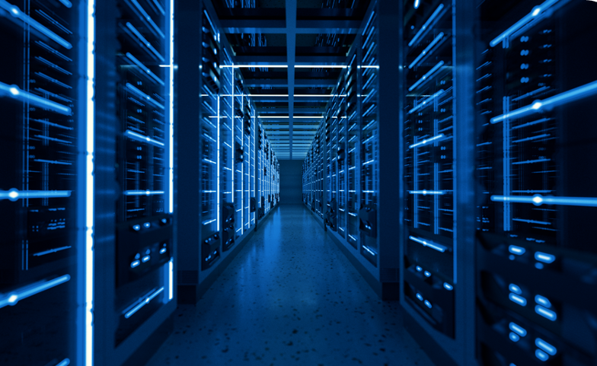
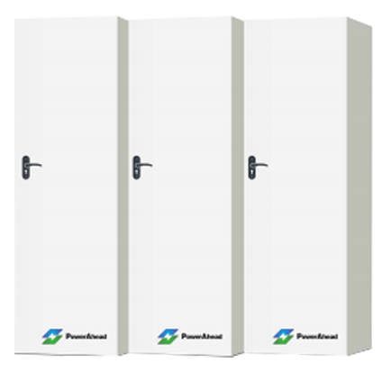
Commercial Energy Storage
Capacity:
100KWh-1.0MWh
22

Slide 23
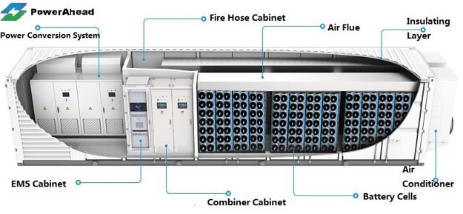
Industrial Energy Storage
Capacity: 1.5 MWh per 20’ container
3.5 MWh per 40’ container
23

Slide 24

Patents & Know How Technology
Cathode material
Anode material
Diaphragm
Electrolyte
Battery Management System
MEGA-SIB Technology Patents
MEGA-SIB Utility Patents
24

Slide 25
Power Ahead Group
Thank You
www.PowerAheadGroup.com
For more information please contact: Info@PowerAheadGroup.com
25

